Slide 1
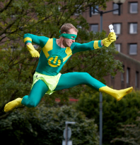
SAVES: Promoting the reduction of energy consumption in student halls
Joanna Romanowicz, Student Switch Off (Europe) Project Manager, NUK UK

Slide 2
The session will be on:
SAVES rationale
What is SAVES
SAVES’ impact
Notes:
2

Slide 3
How many of you are staying at a hotel during this conference?
How many are paying separate utility bills?
How many of you are as conscious of your energy, electricity and water usage as you are in your own home?

Slide 4
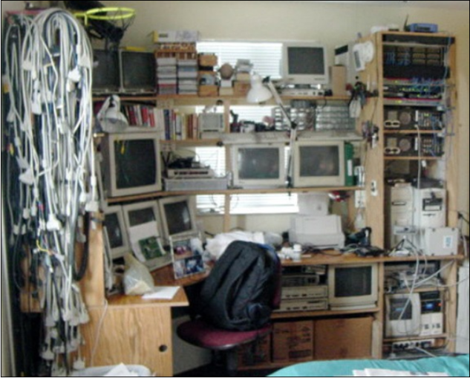
No incentive to save energy in dorms..!
Students pay a fixed rate
Energy wastage – over 30% in UK (University of Sunderland)
Insufficient awareness on energy saving amongst young people
This may lead to… very large bills when students move out to
private accommodation!
Notes:
Evidence – study of 2 halls that were identical – in one paid set amount, in other electricity was paid separately. Usage was over 30% more in the hall that bills were inclusive.

Slide 5
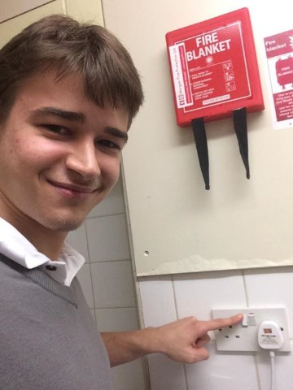
So we decided to do something about energy wastage in dorms… we know:
Habit discontinuity hypothesis - individuals are more likely to adopt pro-environmental behaviours if they go through a lifestyle change (e.g. move away from home to go to university!)
A lot of energy is being wasted at the moment
Simple actions like switching off lights and appliances can have a big cumulative impact
Everyone likes a competition
Saving energy saves CO₂ and money

Slide 6
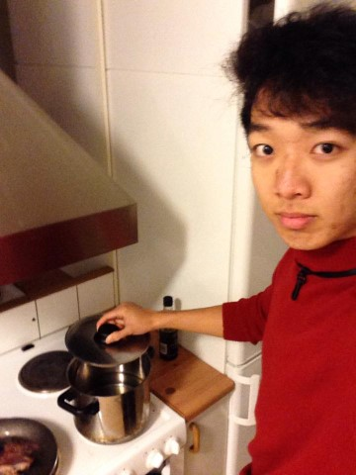
SAVES is an inter-dorm energy saving competition
SAVES (Students Achieving Valuable Energy Savings) is an inter-dormitory energy saving competition within 17 universities in 5 EU countries
SAVES is the overall project name that covers the expansion of the UK Student Switch Off campaign
Competition within/between dorms to see who can reduce their energy usage by the greatest amount or have the lowest usage per student (smart meter data)

Slide 7
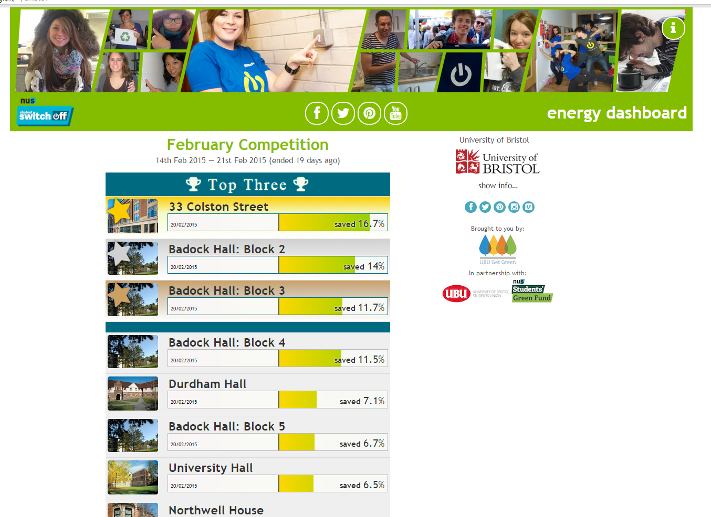
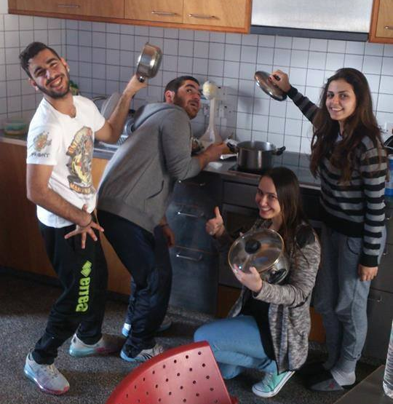
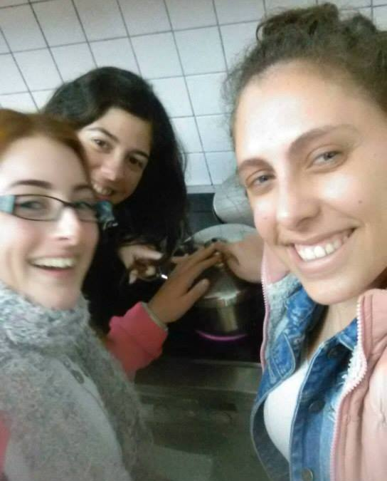
SAVES is fun!
Builds on existing social relationships, peer-to-peer communications, rivalries and communities
A fun approach to raising awareness amongst students
Feedback and prizes to provide incentives for action
National/international winners

Slide 8
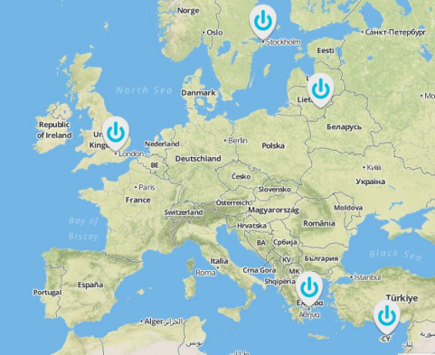
17 Universities in 5 European countries
Participating countries:
UK
Lithuania
Greece
Cyprus
Sweden
25,000 students in SAVES
Funding from April 2014 – March 2017
Notes:
Each country has a dorm coordinator who works with the country specific universities to deliver the student switch off campaign
UNICA – helps with dissemination
DMU – help with technical built
25k in saves (+130k in other uk unis)

Slide 9
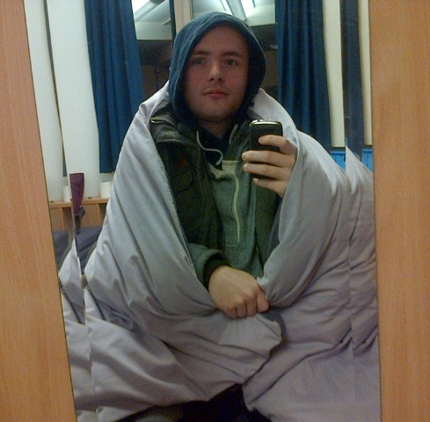
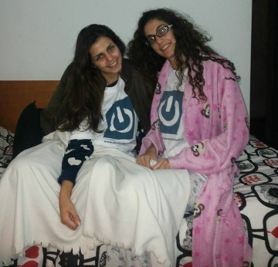
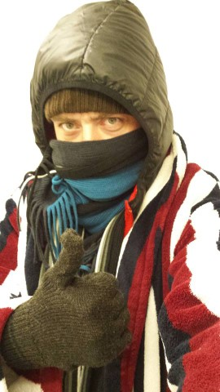
We focus on 4 main energy saving behaviours
Wrapping up warm instead of turning up the heating

Slide 10
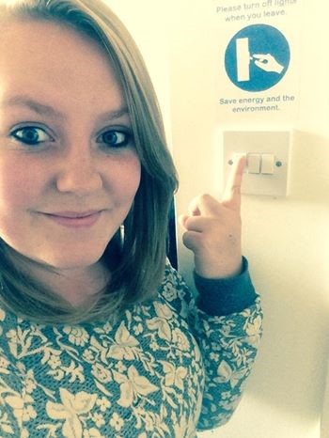
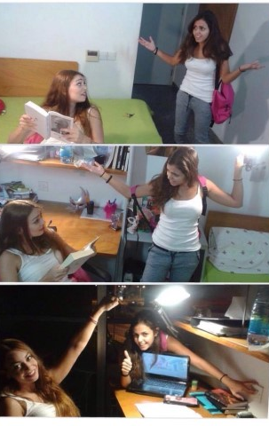
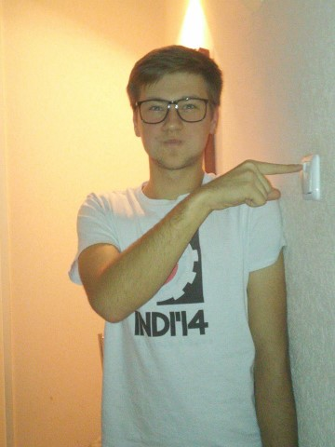
Switching off unnecessary lights and appliances

Slide 11
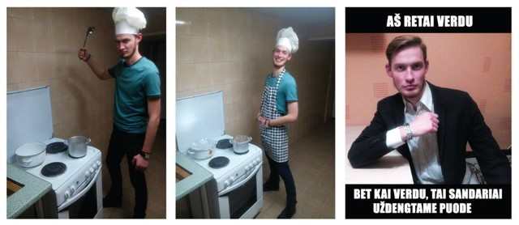
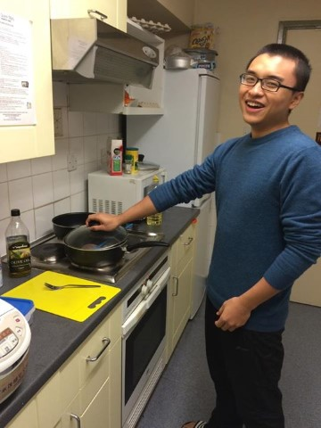
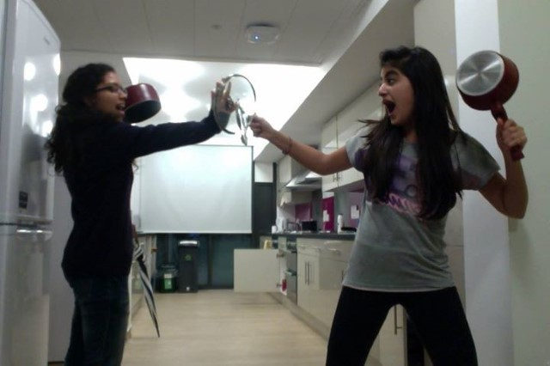
Putting a lid on the pan when cooking

Slide 12
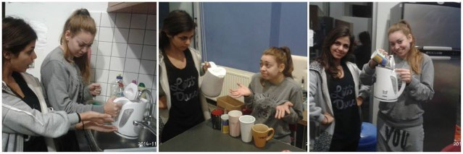
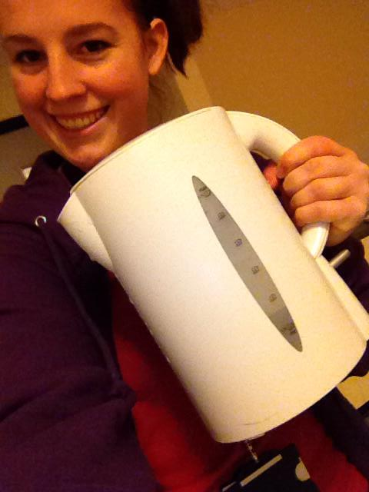
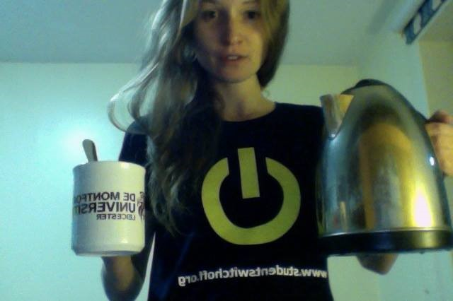
Boiling only the amount of water you need

Slide 13
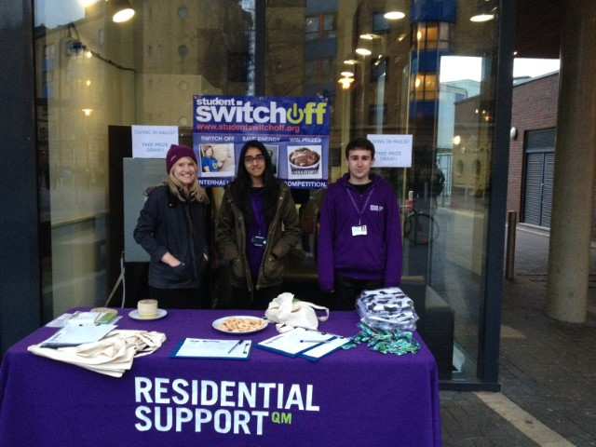
We engage with students throughout the academic year
Online:
Fortnightly energy themed photo competitions on Facebook
Climate quizzes
Emails
Energy updates/dashboard
Face to face:
Dorm visits
Student ambassador training
Energy stalls
End of year party for winning dorm!

Slide 14
We want to create a transnational student community
Twinning
International competitions
Dissemination events
Support from UNICA but also from:
European Students’ Union (ESU)
Erasmus Students Network (ESN)
Environmental Association of Universities and Colleges (ESU)
Students' European Network for Sustainable Development (SENSD)

Slide 15
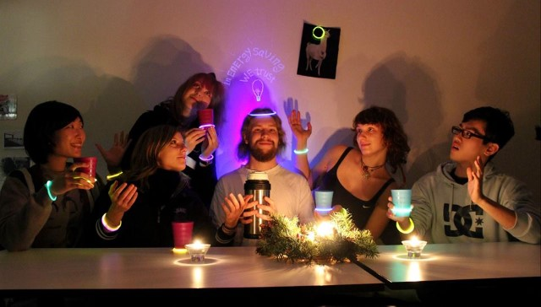
We have 4 main objectives:
Save quantifiable amounts of energy in student dormitories
Create a network of student champions
Develop pro-environmental behaviours amongst students
Develop a self-funding model

Slide 16
We have high aspirations
We want to:
Reach up to 50,000 students over the academic years 2014-15 and 2015-16
Develop an online dashboard to present real-time data from smart meters, allowing international competitions and an energy-saving league
Create a self funded model from University contributions in 6 countries by academic year 2016-17

Slide 17
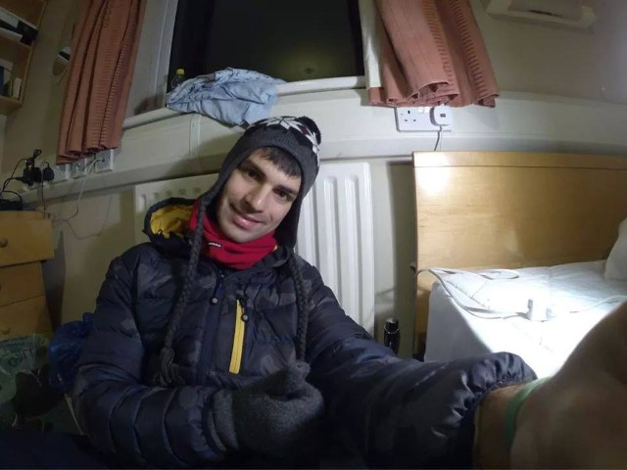
We expect to have wide ranging impacts..
On average achieve 8% savings in energy across all the participating dormitories
15% of students in participating dorms recruited as energy champions
10% swings on target behaviours and 90% of students state that they have carried on their behaviour into private accommodation
2.85GWh energy savings
Project continues to expand reaching over 250,000 students in 6 EU countries by 2016

Slide 18
..and we’ve had encouraging results so far!
Average energy savings of 3% across participating universities in first semester
Over 4,000 students signed up to the campaign (16%)
Over 100 students trained as ambassadors
200 photos submitted in competitions
2,000 participants in climate quizzes
Enthusiasm from participating
universities

Slide 19
Bringing Student Switch off to your campus
Campaign is widely applicable
We can help you with:
Setting up the campaign
Offer virtual support
Create resources that you can use

Slide 20
Any questions?

Slide 21
Please get in touch ☺
Joanna Romanowicz
Student Switch Off (Europe) Project Manager
Joanna.romanowicz@nus.org.uk
0044 7970 296976
www.saves-project.eu

